Slide 1
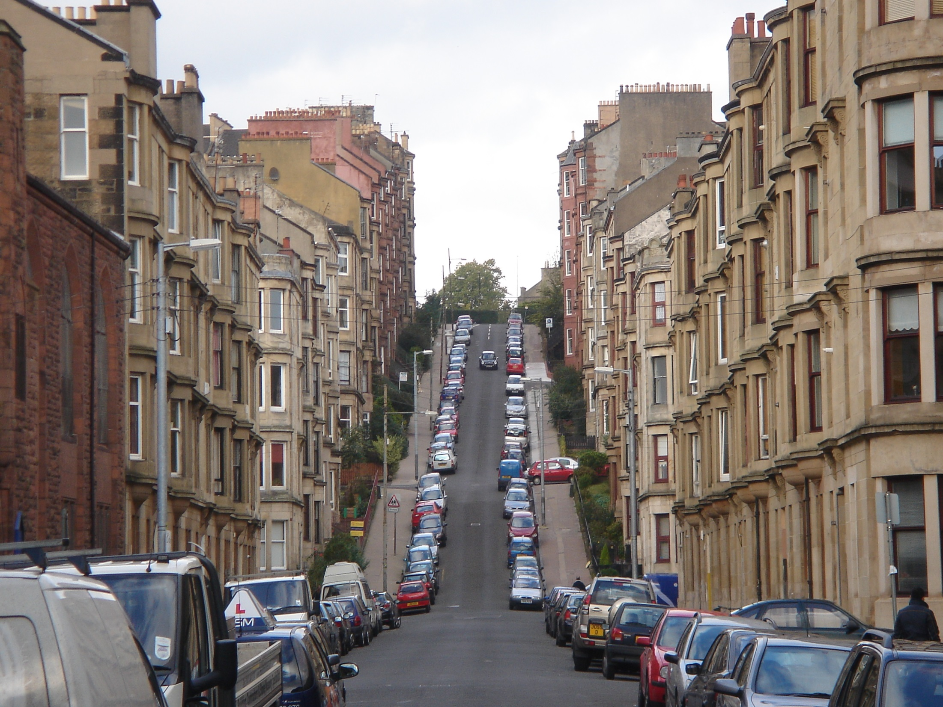
Why is Glasgow so hilly???
By Matthew Staitis

Slide 2
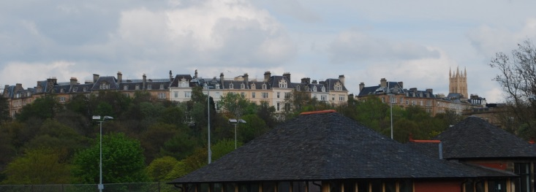
Introduction
Glasgow is very hilly - obviously
But why?
Why are there hills here?
What caused them?
How did they form?

Slide 3
What is a Drumlin?
In Glasgow (hill = drumlin)
‘Drumlin’ is derived from the Gaelic word for ‘a rounded hill’.
They have a ‘tear-drop’ or egg shape.
They are found together in field or swarms.
The are largely made of glacial till (debris), with some having a rocky core.
Ref: Geography Summer School

Slide 4
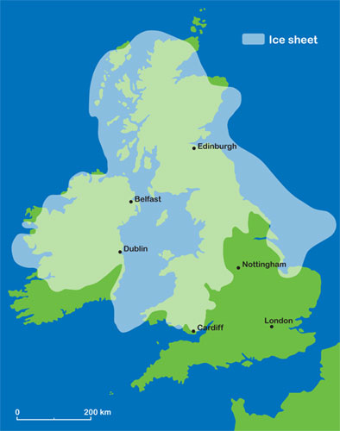
The Ice Age
From 2.6 million to 11,500 years ago.
Ice sheets advanced over most of the Northern Hemisphere.
Not one, but several ice ages with warmer (interglacial) periods in-between.

Slide 5
Glasgow- now and then
Today
20,000 years ago

Slide 6
Icecap Thickness
x18

Slide 7
Glasgow’s Drumlins
Ref: Geography Summer School

Slide 8
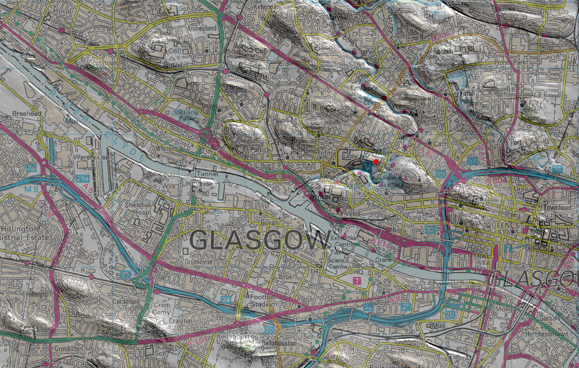
Ref: Geography Summer School

Slide 9
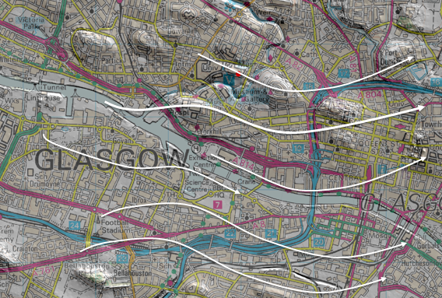
Ref: Geography Summer School

Slide 10
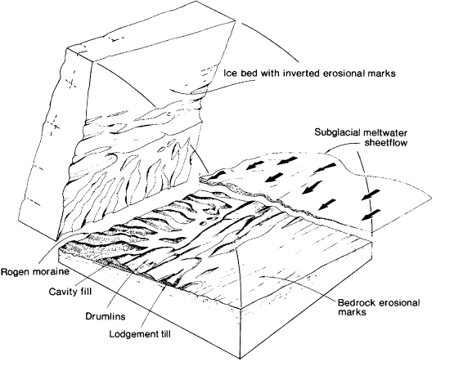
The Deformation Theory
The Deformation Theory of Drumlin formation suggests:
Cause- weight of ice
Details- soft till is deformed and moulded by the ice. Shear stress causes softer sediment to form drumlins.

Slide 11
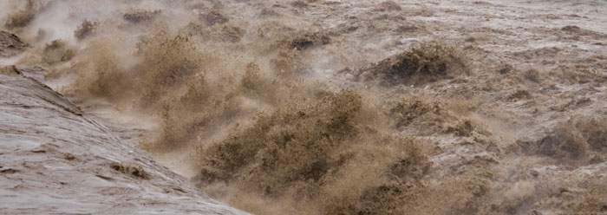
The Fluvial Theory
The Fluvial Theory of Drumlin formation suggests:
Cause- catastrophic meltwater floods
Details- cavities eroded by ice, are filled with sediment derived from the meltwater. These filled cavities become drumlins

Slide 12
Summary
A Drumlin is a hill formed due to the Ice age.
Glasgow was buried under a mile thick ice sheet.
Drumlins are everywhere, Glasgow is built on them.
There are 2 theories on Drumlin formation- both not proven.
THIS IS WHY GLASGOW IS SO HILLY!!!

